Slide 1


Slide 2

Dealing with Imbalanced DataSets

Slide 3

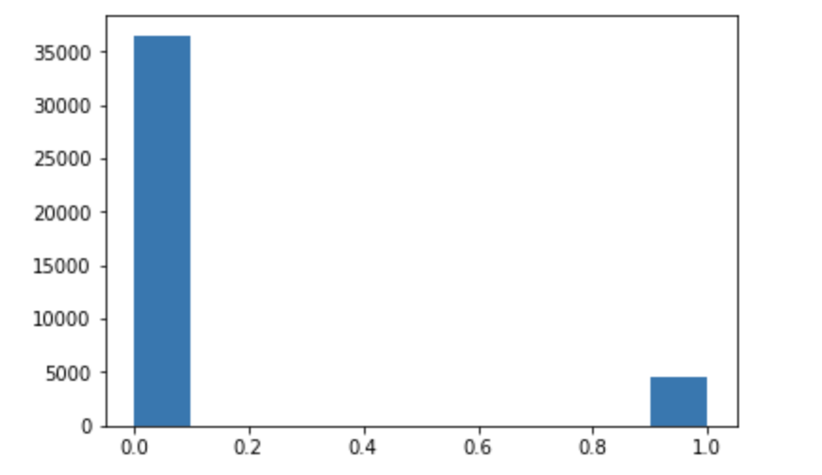
Whats the exact problem?
Non-Defaulters
Count
Defaulters
Notes:
unequally represented in Training data

Slide 4
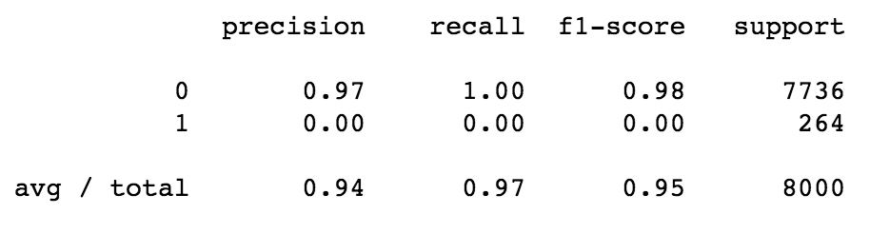
What's the consequence?
Poor performance on minority Class with most models (some are not as bad as others)

Slide 5
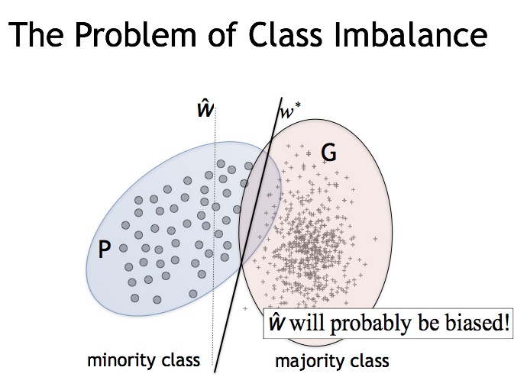

Slide 6
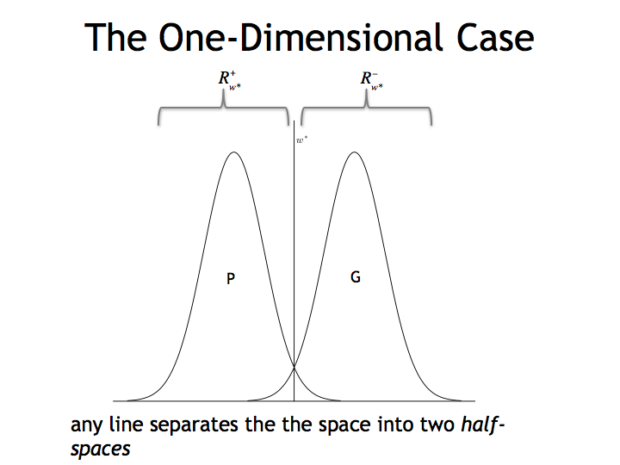

Slide 7
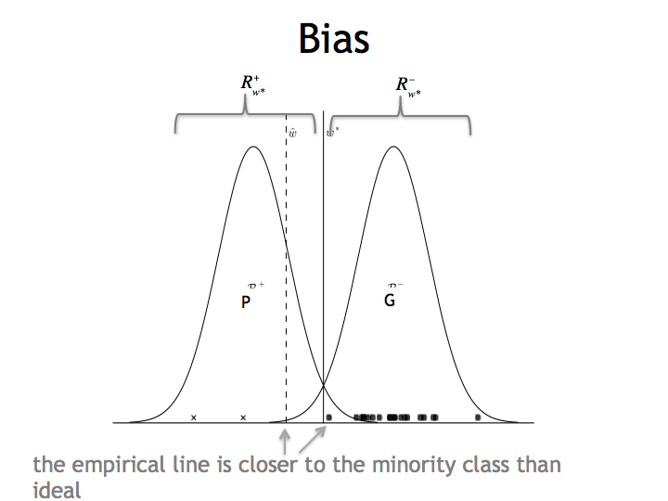

Slide 8
Where do we see this?
Class imbalance is everywhere: disease screening, fraud detection, text classification (often), …
Typically the minority class is what we care about One of ten top challenging issues in data mining [who said this? → International Conference on Data Mining 05]

Slide 9
Solutions
Threshold Selection
Undersampling/Oversampling
SMOTE: Synthetic Minority Oversampling Technique

Slide 10
Threshold Selection
Choose a more appropriate probability cut-off

Slide 11
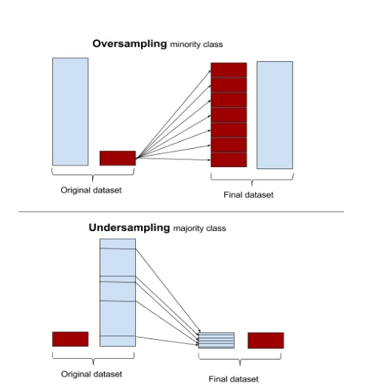
Undersampling/Oversampling

Slide 12
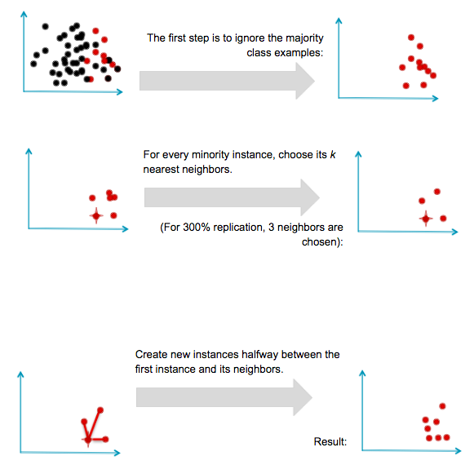
SMOTE: Synthetic Minority Oversampling Technique

Slide 13
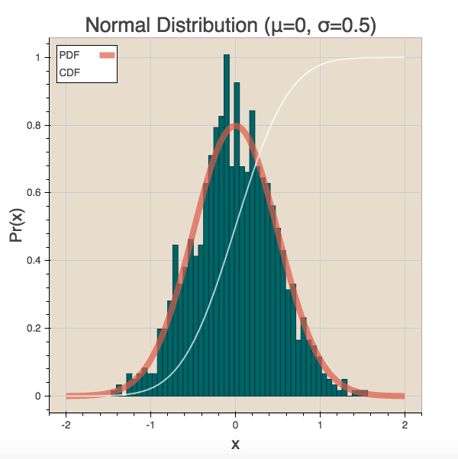
Example: A normal distribution
Notes:
This is a normal distribution. Normal distributions are used to describe commonly occuring probability distirbutions for random variables.

Slide 14
Probability Distributions and Variables
Probability distribution can describe two types of events/variables: discrete and continuous.
A discrete variable is a variable that can only take on certain countable values. For example the number of houses in a street can be 1,2, 3 etc. but not 2.5 or 3.4.
Continuous variables on the other hand can take on any values. Time, for example, is a continuous variable.
Both discrete and continuous variables are forms of a random variable; a variable whose numerical value is determined by chance.

Slide 15
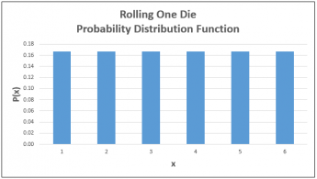
Probability Distributions

Slide 16
Describing Probability Distributions
If we revisit the normal distribution, we notice that the distribution is centered around something and has a certain width.
That something is its mean and the width is its variance.
Variance
Mean

Slide 17
Mean and Variance: Discrete Variables
The mean, also known as expected value, of a discrete variable [X] is the weighted sum of all possible values of [X] . The weight here is the probability of value of [X] .
𝞵 = E[X] = ∑ X_{i}*P[X_{i}]
If X_{i} is the number expected to appear when a die is rolled:
E[X] = ⅙ (1) + ⅙ (2) + ⅙ (3) + ⅙ (4) + ⅙ (5) + ⅙ (6) = 3.5
Obviously we will never observe this number, but this represents the long-run mean for a die.

Slide 18
Mean and Variance: Discrete Variables
The variance is the extent to which outcomes differ from the expected value.
𝞼² = E[X - 𝝁]² = ∑ (X_{i} - 𝝁)² *P[X_{i}]
Variance, then, can be interpreted as the expected value of: [X - 𝝁]²
What is the square all about? Well, the variance is actually the square of another prob. dist. descriptor called the standard deviation. The standard deviation is:
√𝜎² = 𝜎
Notes:
the standard deviation is easier to interpret than the variance as it has the same units as X and mu (for example dolllars)

Slide 19
Binomial Distribution (Discrete)
Used to describe situation where there are:
n identical trials
- 2 possible outcomes
- Prob. of success is same for each trial
Mean = ∑np (where n is # of trial, and p is prob. of each trial)
Standard deviation = ∑sqrt(np(1-p))
Notes:
To find the prob. (P(X=x)) = ^{k}C_{x} * P(x)^{x} (1-p)^{K-x}
5choose1 ways * ((⅔) * (⅓)*(⅓)*(⅓)*(⅓)
(5!/(1!4!) * ((⅔)^1 * (⅓)^4 = 0.04

Slide 20
Binomial Distribution
We Pick 5 balls (X=5), what is the probability of picking 1 Black and 4 red ? There are ⅔ black balls and ⅓ red balls.
Notes:
To find the prob. (P(X=x)) = ^{k}C_{x} * P(x)^{x} (1-p)^{K-x}
5choose1 ways * ((⅔) * (⅓)*(⅓)*(⅓)*(⅓)
(5!/(1!4!) * ((⅔)^1 * (⅓)^4 = 0.04

Slide 21
Poisson Distribution
What if we have a situation where events randomly occur across time or intervals. What we ask here is, “What is the probability of observing X=x events in a given interval”. P(X=x) = (e^{-ƛ} * ƛ^{x}) / x! [ e = 2.79]
Mean = ƛ
Variance = ƛ
Lambda is the mean number of events per interval.
Births in a hospital occur at an average of 1.8 births per hour. What is the prob. of 4 birth per interval (given mean is 1.8)? What is the prob. of 2 or more births per interval? What is the prob. of observing 5 births in 2 hours?
Notes:
To find the prob. (P(X=x)) = ^{k}C_{x} * P(x)^{x} (1-p)^{K-x}
5choose1 ways * ((⅔) * (⅓)*(⅓)*(⅓)*(⅓)
(5!/(1!4!) * ((⅔)^1 * (⅓)^4 = 0.04

Slide 22


Mean and Variance: Continuous Variables
The mean and variance of continuous variables are trickier. Instead of calculating the sum, we would calculate the integral of
Similarly, the variance is:
CDF:
Notes:
the standard deviation is easier to interpret than the variance as it has the same units as X and mu (for example dolllars)

Slide 23
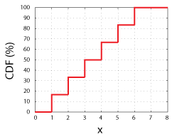
Mean and Variance: Continuous Variables
This function, CDF(x), simply tells us the odds of measuring any value up to and including x.
Notes:
the standard deviation is easier to interpret than the variance as it has the same units as X and mu (for example dolllars)

Slide 24
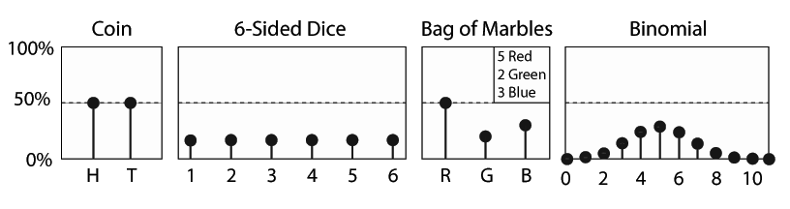
Mean and Variance: Continuous Variables
The PDF is the derivative of the CDF. 𝐹(𝑥)=∫^{𝑥}_{−∞} 𝑓(𝑥′)𝑑𝑥. It is very similar to the probability of the random variable at specific value.
Notes:
the standard deviation is easier to interpret than the variance as it has the same units as X and mu (for example dolllars)

Slide 25
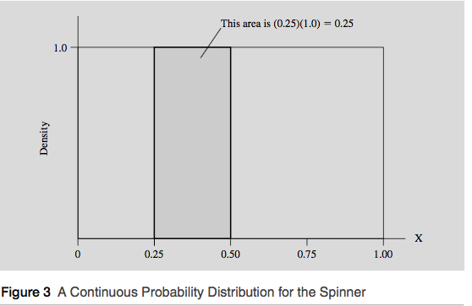
Mean and Variance: Continuous Variables
Due to the problem of uncountability, how can we assign positive possibilities where the sum will be 1?
Instead, we can assign probabilities to intervals of outcomes instead of individual outcomes.
Notes:
the standard deviation is easier to interpret than the variance as it has the same units as X and mu (for example dolllars)

Slide 26
Mean and Variance: Continuous Variables
This is called a probability density function.
The density curve for a continuous random variable is analogous to the probability distribution for a discrete random variable, and the population mean and the standard deviation have the same interpretation.
Notes:
the standard deviation is easier to interpret than the variance as it has the same units as X and mu (for example dolllars)

Slide 27
Standard Variables: A common descriptor
Different random variables are measure differently (stock prices, height etc.)
To describe a rarely occurring random variables, we may say “Someone who is 1 foot taller than the average indian male only has a 0.007 chance of existing”
However, it is difficult to compare measurements across random variables.
In the eighteenth and nineteenth centuries, researchers dis- covered that when variables are standardized their probability distributions are often virtually identical!
Notes:
the standard deviation is easier to interpret than the variance as it has the same units as X and mu (for example dolllars)

Slide 28

Standard Variables: A common descriptor
One way to standardize variables is to transform their mean and variance so that different variables have the same mean and the same standard deviation.
To standardize a random variable X, we subtract X_{i} from its mean and then divide by its standard deviation :
Z measures how many standard deviations X is above or below its mean. If X is equal to its mean, Z is equal to 0. If X is one standard deviation above its mean, Z is equal to 1.
Notes:
the standard deviation is easier to interpret than the variance as it has the same units as X and mu (for example dolllars)

Slide 29
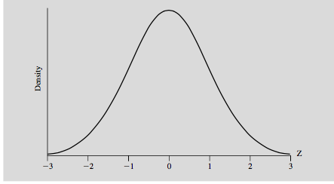
Normal distribution and the Central Limit Theorem
The theorem states that if Z is a standardized sum of N independent, identically distributed (discrete or continuous) random variables with a finite, non-zero standard deviation, then the probability distribution of Z approaches the normal distribution as N increases.
A normal distribution is just a bell shaped curve
Notes:
the standard deviation is easier to interpret than the variance as it has the same units as X and mu (for example dolllars)

Slide 30
Normal distribution and the Central Limit Theorem
The normal distribution is important because it so often appears even when N is quite small. An N above 30 is usually sufficient to achieve a normal distribution.
The 68,95,99 rule: P[-1 < Z <1]= 0.68 P[-2 < Z < 2]= 0.95 P[-3 < Z < 3] = 0.99
Notes:
the standard deviation is easier to interpret than the variance as it has the same units as X and mu (for example dolllars)

Slide 31
Sampling
Until now, our discussions of probability distributions, means and standard deviations have been actually about the Population. The population is the entire group of items that interests us.
To say the “mean height of indian men” can either imply:
The entire population of indian was used to determine the mean
A sample of indian men were randomly selected to be representational of the population.
Often we are unable to measure the entire population and are left taking samples of the population. Care must be taken in inferring or estimating from the sample.
Notes:
the standard deviation is easier to interpret than the variance as it has the same units as X and mu (for example dolllars)

Slide 32
Estimation
Let X_{bytemean} be the “sample average” of the 30 students in our class.
It is tempting to regard a sample average as definitive. Our particular sample is just one of many samples that might have been selected; other samples would yield somewhat different sample averages.
But we can use probabilities to deduce how likely it is that a sample will be selected whose mean is close to the population mean.
Notes:
the standard deviation is easier to interpret than the variance as it has the same units as X and mu (for example dolllars)

Slide 33

Estimation
The mean and standard deviation of our sample are similar to the population mean and standard deviation:
We will use these to determine the confidence interval that the sample mean is close to the population mean.
Notes:
the standard deviation is easier to interpret than the variance as it has the same units as X and mu (for example dolllars)

Slide 34
Student’s t-distribution
A statistician, Gosset, found that sample distributions, for samples larger than 30, were also normally distributed. This means that now we can use the normal distribution to determine the likelihood of an event occurring. In the example we will take, we will analyze the likelihood of a sample mean occurring. Specifically, we will create an interval such that we want to be 95% (or some other %-level) sure that our interval encompasses the true population mean. So given a sample mean, we are evaluating its proximity to the true mean by creating an interval in which we say that if repeated samples were taken and the 95% confidence interval computed for each sample, 95% of the intervals would contain the population mean. Naturally, 5% of the intervals would not contain the population mean.
Notes:
the standard deviation is easier to interpret than the variance as it has the same units as X and mu (for example dolllars)

Slide 35

Confidence Interval Formula
So we are standardizing our sample data. Then we are choosing a level of confidence we want (how sure we want to be of our results) and then we use the above formula.
Notes:
the standard deviation is easier to interpret than the variance as it has the same units as X and mu (for example dolllars)

Slide 36
Example: Creating a 95% and 99% confidence interval
A group of 30 foot surgery patients had a mean weight of 240 pounds. The standard deviation for foot patients is 25 pounds. Find a confidence interval for a sample for the true mean weight of all foot surgery patients. Find a 95% CI.
Step 1: Find Degrees of Freedom = N-1 = 30-1 = 29 Step 2: Choose a confidence level (0.05) and divide by 2 = 0.025 Step 3: Identify a critical t using Students t- table = 2.045 Step 4: Calculate sample standard error = 25/sq.root(30) = 4.5
Notes:
If repeated samples were taken and the 95% confidence interval computed for each sample, 95% of the intervals would contain the population mean. Naturally, 5% of the intervals would not contain the population mean.

Slide 37
Contd.
Step 5: Plug in the values to the formula 240 + 2.045(4.5)
The lowerbound is 230.8 and the upper is 248.2. Now we can say that if repated samples and confidence intervals were taken, 95% of the intervals would contain a mean between these two numbers.
For the 99% level: 240 + 2.75(4.5) We notice that if we want to be more sure of our result we have a wider interval.
Notes:
the standard deviation is easier to interpret than the variance as it has the same units as X and mu (for example dolllars)

Slide 38
Hypothesis Testing
In Hypothesis testing, our goal is to evaluate our results. Specifically, to understand if our results are statistically significant or not. Is it likely that our results could have been obtained by chance?
Example: While licensing new medicines, the Central Drugs Standard Control test the medicines for side effects. If the sample of people exposed to the new product shows some side effect significantly more frequently than would be expected to occur by chance, the product is held back.
This is not PROOF that the medicines have side effects, but with a certain level of confidence/significance (95%) we can state these results are unlikely “normal”.
Notes:
the standard deviation is easier to interpret than the variance as it has the same units as X and mu (for example dolllars)

Slide 39
Setting up: Null and Alternative Hypothesis
H₀: The Null Hypothesis states the “default”. For example, in the medicines our default is that the medicines have no side-effects. This may be proxied by saying that blood pressure levels are “normal/average”.
H_{a}: The Alternative Hypothesis is the opposite of the default. In our example, this may be that blood pressure level are NOT “normal/average”. Another valid alternative hypothesis is that the blood pressure level are ABOVE “normal/average”. H₀: B_{control} = B_{intervention} H_{a}:B_{control} ≄B_{intervention}
Notes:
the standard deviation is easier to interpret than the variance as it has the same units as X and mu (for example dolllars)

Slide 40
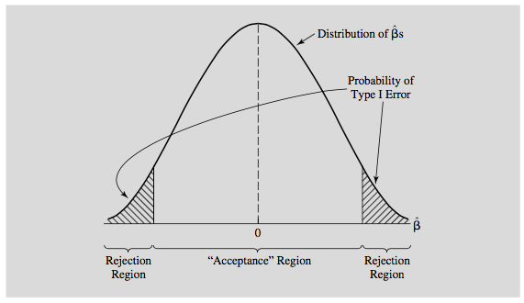
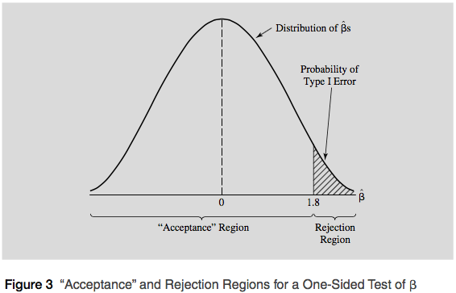
Setting up: Continued
There are two types of alternative hypothesis. One where we are “agnostic” and do not suppose to know the direction of change. This is a two-sided test.
On the other hand, we may have a suspicion (for example that the medicine increases blood pressure and test for that specifically. This is a one-sided test.
Notes:
the standard deviation is easier to interpret than the variance as it has the same units as X and mu (for example dolllars)

Slide 41
Type I and Type II error
We can possibly make one of two errors in hypothesis testing: Type I: We reject a true null hypothesis. Type II: We do not reject a false null hypothesis.
So in our medicines example, a type I error would be reject the null hypothesis that there is no blood pressure variation when in fact the opposite was true.
A type II error would be to not reject the Null when we should have.
A type II error is usually more critical to avoid than Type I since we would be passing a medication that may have side-effects.
Notes:
the standard deviation is easier to interpret than the variance as it has the same units as X and mu (for example dolllars)

Slide 42
Making a decision: Accepting or Rejecting the Null
To accept or reject the null hypothesis we need a critical t-value. A critical t-value is the value that distinguishes the “acceptance” region from the rejection region.
The rejection region measures the probability of a Type I Error if the null hypothesis is true. Unfortunately, decreasing the chance of a Type I Error means increasing the chance of a Type II Error since if you make the rejection region so small that you almost never reject a true null hypothesis, then you’re going to be unable to reject almost every null hypothesis, whether they’re true or not!
So, after choosing a critical t, we the t-value for our particular observation (t_{k}) and compare it with the critical t. We Reject H₀ if |t_{k}|> tc and if tk also has the sign implied by H_{a}. Do not reject H₀ otherwise.
Notes:
the standard deviation is easier to interpret than the variance as it has the same units as X and mu (for example dolllars)

Slide 43
Example
Suppose we want to evaluate the impact of a diet plan. We have two groups of 30 people each, one which underwent no diet (control) and the other that underwent diet (intervention). Prior to the study, each member of the group was 65kg. Below are the summary statistics of the two groups post the study.
No Diet Diet Mean weight = 65 Mean weight = 64.1 S.D = 3.8 S.D = 3.4 S.E = 3.8/sq.root(30) S.E = 3.4/sq.root(30)
Notes:
the standard deviation is easier to interpret than the variance as it has the same units as X and mu (for example dolllars)

Slide 44
Example: Continued
What is our null and alternative hypothesis here?
Null hypothesis : No difference in weight loss between diet and no-diet Delta = 0 Alternative: Diet-takes experienced more weight loss than non-diet takers (ONE-SIDED) DELTA > 0
Critical t : 1.699
Notes:
the standard deviation is easier to interpret than the variance as it has the same units as X and mu (for example dolllars)

Slide 45
Example
Now we need to calculate our t-value (t_{k}) . This gives us the likelyhood of observing our mean values.
The total weight loss was 0.9kg. Was this significant?
T_{k} = 0.9 - 0 = 0.96
0.93 = sqrt(SE_{no-diet}² + SE_{diet}²)
Since our (t_{k}) of 0.96 is less than our t_{c} of 1.69, we cannot reject the null.
Notes:
the standard deviation is easier to interpret than the variance as it has the same units as X and mu (for example dolllars)

Slide 46
Hypothesis Testing: Another way
A p-value for a t-score is the probability of observing a t-score that size or larger.
We don’t need to caclulate it as Sklearn and Statsmodel provide them for us.
It tells us the lowest level of significance at which we could reject the null hypothesis
So, if a p-value, always between 0 and 1, is low it is casting doubt on the null hypothesis and a high p-value is agreeing with null hypothesis. Here again, to reject or accept the null, we need a critical value and the common one is 0.05.
In our diet example, the P-value for conducting the one-sided test H₀ : μ_{pre-diet} = μ_{post-diet} versus H_{a} : μ_{pre-diet} < μ_{post-diet} is the probability that we would observe a test statistic greater than t* = 1.69 if the pre-diet mean μ was really equal to post-diet mean.
Notes:
the standard deviation is easier to interpret than the variance as it has the same units as X and mu (for example dolllars)

Slide 47


